Slide 1
SharePoint Framework Extensions
Future of SharePoint Development
Alex Terentiev

Slide 2





About Myself
Custom solutions architect and lead developer in Sharepointalist Inc.
10 years of experience with SharePoint
Expert in Front-end development and modern web development toolchain
Leading development of multiple SharePoint products sold worldwide
Regular contributor to SharePoint Patterns and Practices
Awarded with 1st prize award during invite-only SharePoint Dev Kitchen March 2017 event
2017 European SharePoint Community Awards Finalist
@alexaterentiev
http://blog.aterentiev.com/
https://github.com/AJIXuMuK
https://www.linkedin.com/in/alekseiterentiev/

Slide 3
Agenda
What is SharePoint Framework?
SharePoint Framework Development Overview
SharePoint Framework Extensions Overview
SharePoint Framework Extensions Demos

Slide 4
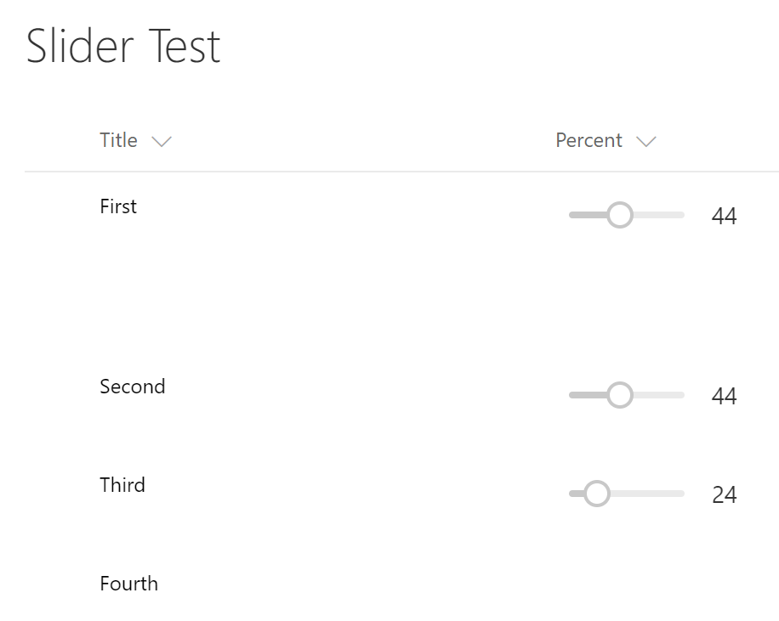
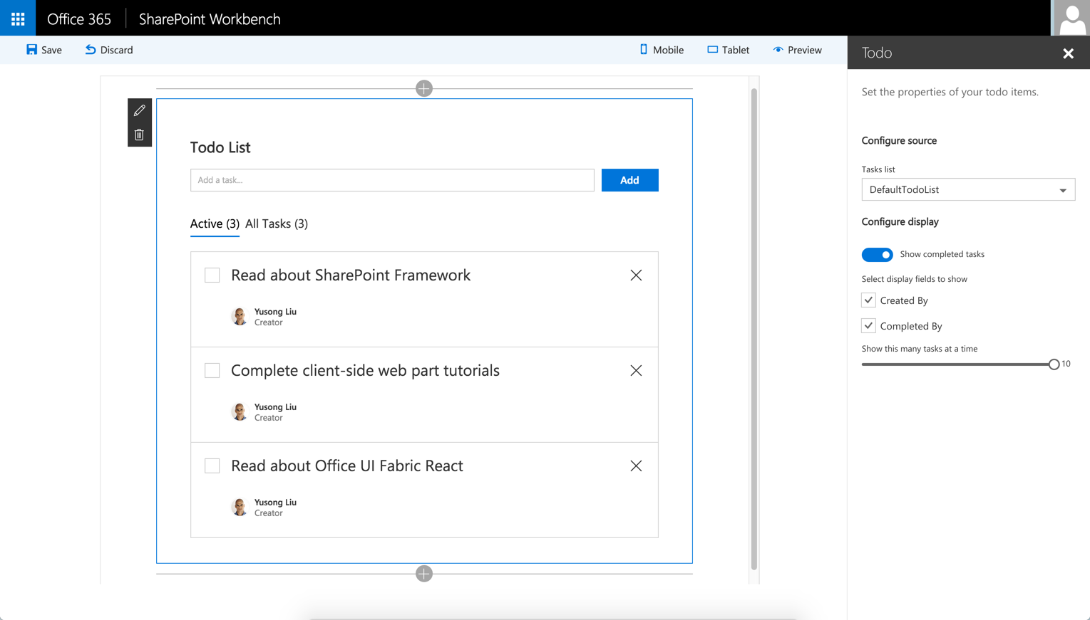
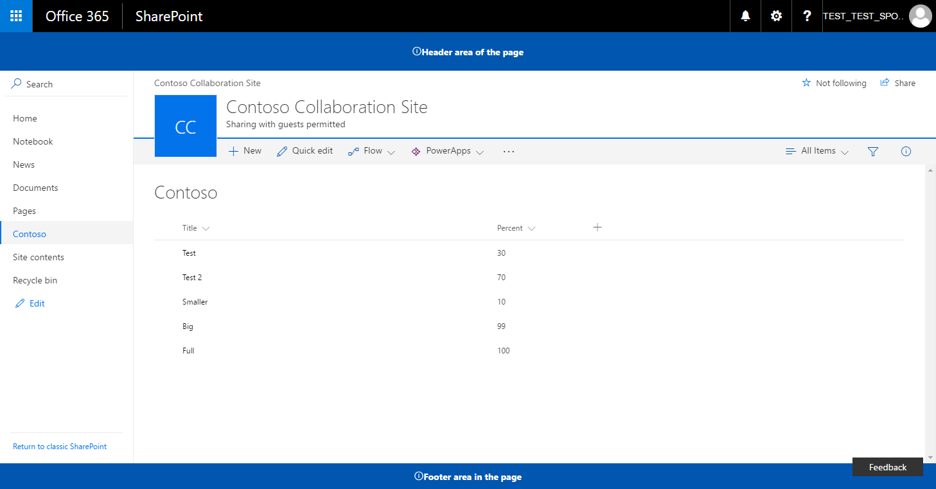
What is SharePoint Framework (SPFx)?
What is SharePoint Framework?
SharePoint Framework Development Overview
SharePoint Framework Extensions Overview
SharePoint Framework Extensions Demos

Slide 5
What is SharePoint Framework (SPFx)?
The SharePoint Framework (SPFx) is a modern way to develop SharePoint customizations.
Key Features:
Runs in the context of the current user and connection in the browser
It's framework agnostic
The toolchain is based on commonly used client development tools
The controls are rendered in the normal page DOM
Performance is reliable
The controls are responsive and accessible
SPFx web parts can be added to both classic and modern pages
Enables the developer to access page lifecycle

Slide 6

SPFx Security Considerations
Code is executed in browser and under current user context – no elevated privileges or any other security concerns
SPFx solution is a package that should be added to the App Catalog (tenant-scoped or site-collection-scoped) and approved by an administrator
All SPFx assets (JavaScript, images, CSS, etc.) are hosted by default on tenant-scoped CDN (Office 365 CDN)

Slide 7






SPFx Development Overview
What is SharePoint Framework?
SharePoint Framework Development Overview
SharePoint Framework Extensions Overview
SharePoint Framework Extensions Demos

Slide 8
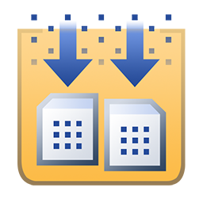




SPFx Development Toolchain
Project Templates
IIS Express
MS Build
Typed superset of JavaScript that
compiles to plain JavaScript
Package manager to reference dependencies
Environment for hosting and serving JavaScript code.
Task runner and module bundler to compile and package solutions
Templates engine

Slide 9
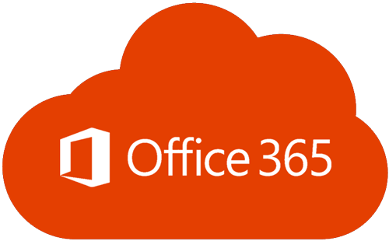



SPFx Development: How to Start?
Create Office 365 Tenant (Recommendation: Office 365 Enterprise E3 Developer subscription tenant)
Set up development environment:
Set up local development environment
Use Docker Image by Waldek Mastykarz (https://goo.gl/fzNV7P)

Slide 10

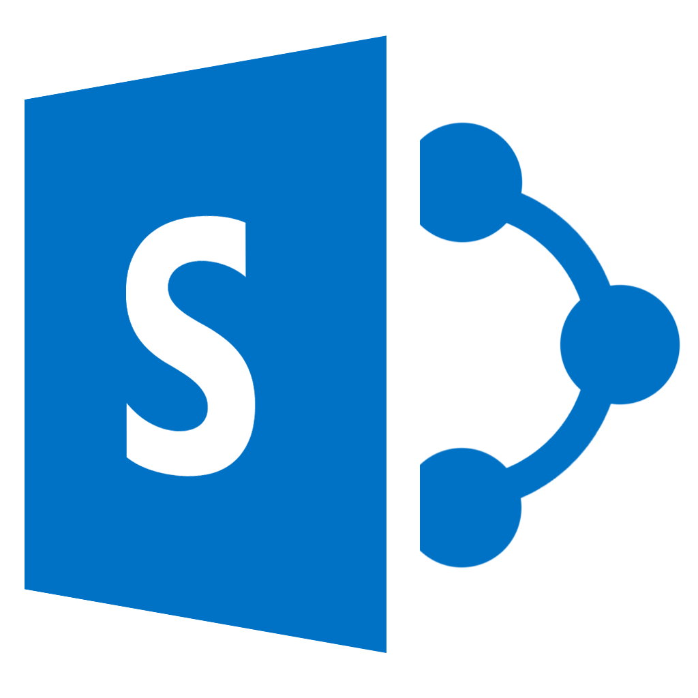
SPFx Development Flow
Install SPFx Templates (generator)
Compile, Bundle
Package
Create Project from Template
Test
Deploy to Storage
Reference Additional Libraries
Ready to Ship?
Yes
Implement Custom Code
Add to App Catalog and on the Site
Manually, using ALM API (https://goo.gl/Jpjiag), or installSPFxSolution Site Script Action (https://goo.gl/5ZQhui)
No

Slide 11

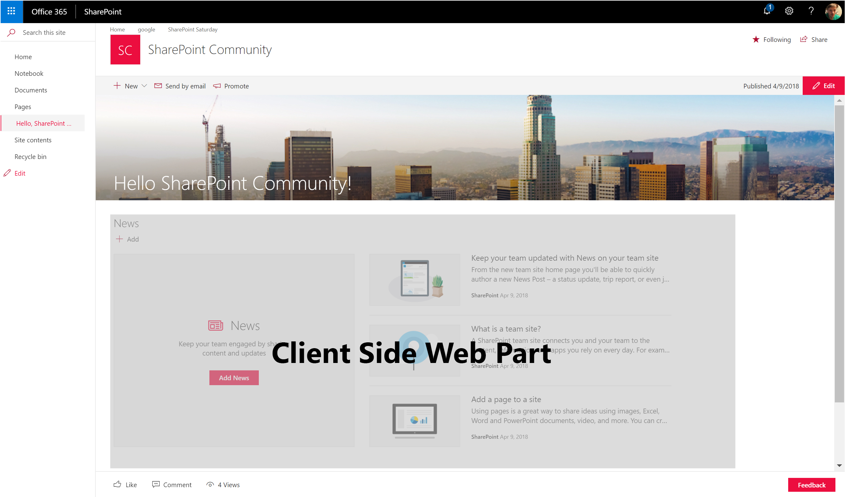
Packaging, Deployment, Hosting
Default (v 1.4+)
Custom
package-solution.json
write-manifests.json
package-solution.json
write-manifests.json
"includeClientSideAssets": true
"cdnBasePath": "<!-- PATH TO CDN -->"
"includeClientSideAssets": false
"cdnBasePath": “https://cdn.contoso.com"
.sppkg
assets
.sppkg
Office 365 Public CDN
Custom CDN
Developer is responsible for assets’ deployment to custom CDN or other type of storage.
All assets are included in .sppkg
App Catalog
All assets are automatically extracted to the hidden document library and served either directly or using Office 365 Public CDN (based on tenant configuration)
Only manifest and declarations are included in .sppkg

Slide 12
Packaging, Deployment, Hosting
DEMO

Slide 13
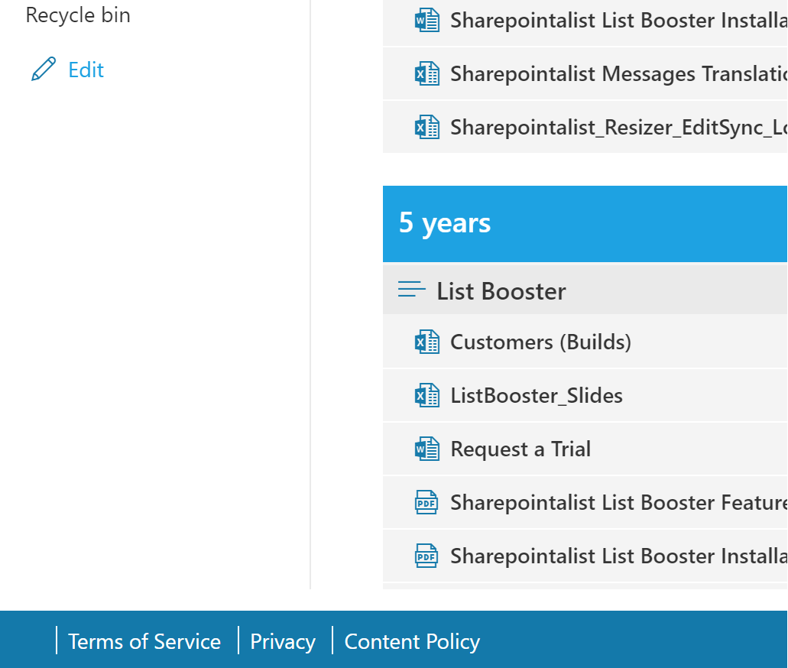
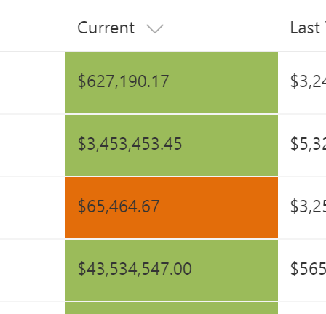
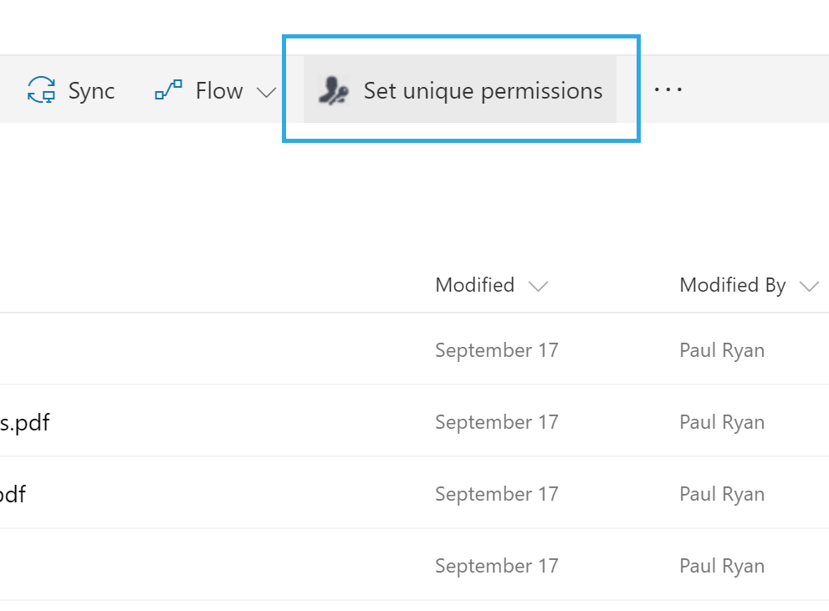
SPFx Extensions Overview
What is SharePoint Framework?
SharePoint Framework Development Overview
SharePoint Framework Extensions Overview
SharePoint Framework Extensions Demos

Slide 14
SPFx Extensions Types

Slide 15
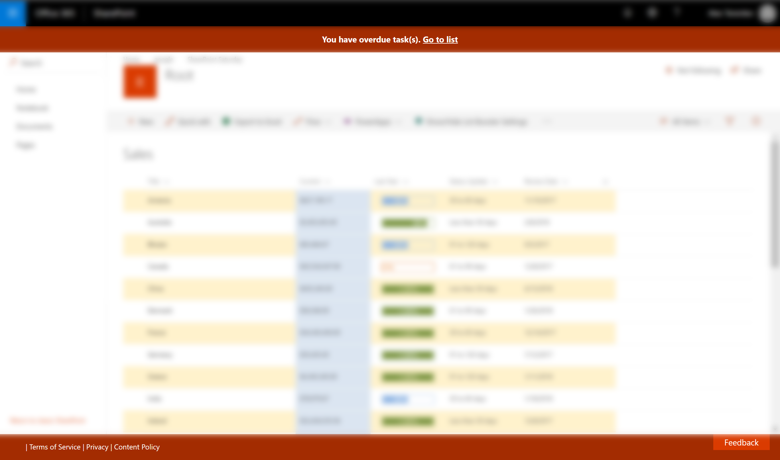
SPFx Extensions Types
Application Customizer can be embedded to Page Header or Page Footer… or be invisible.

Slide 16
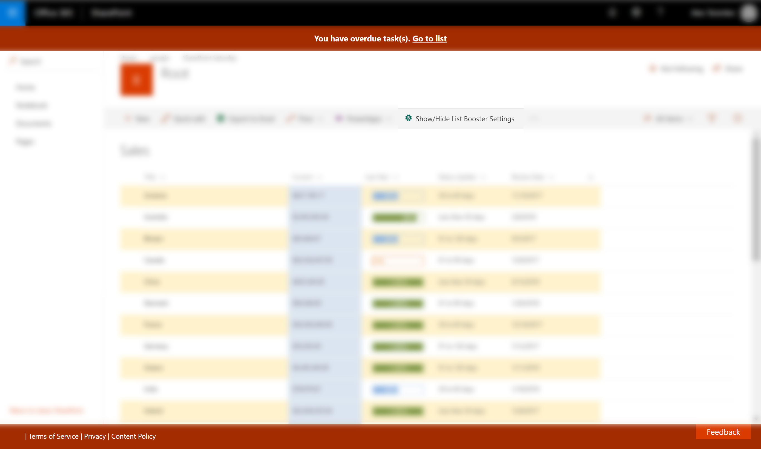
SPFx Extensions Types
Application Customizer can be embedded to Page Header or Page Footer… or be invisible.
Command Set Customizer is used to add new custom actions to the list Command Bar and List Item Context Menu

Slide 17

SPFx Extensions Types
Application Customizer can be embedded to Page Header or Page Footer… or be invisible.
Field Customizer is used to apply custom experience (rendering) to specific fields
Command Set Customizer is used to add new custom actions to the list Command Bar and List Item Context Menu

Slide 18
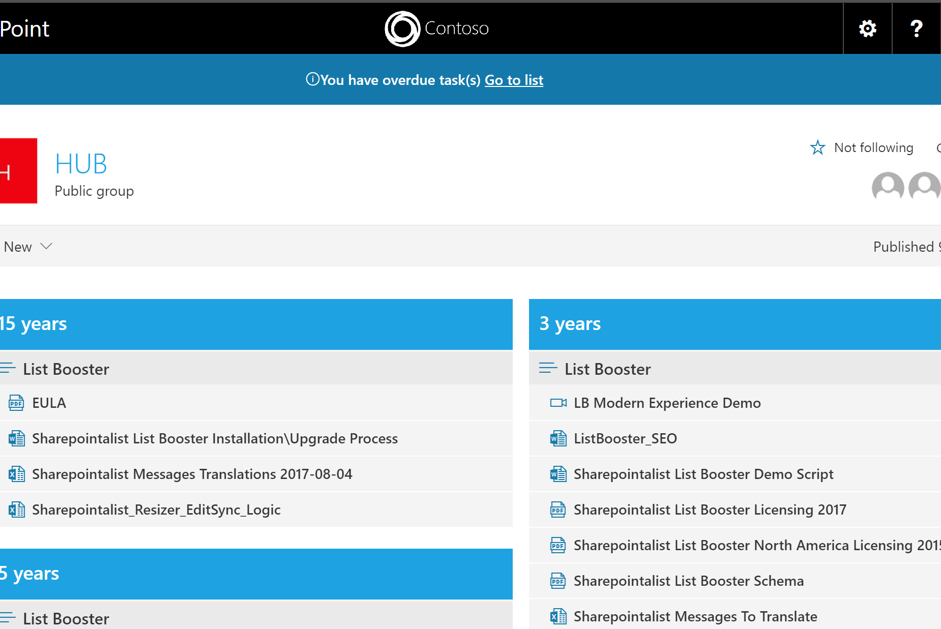
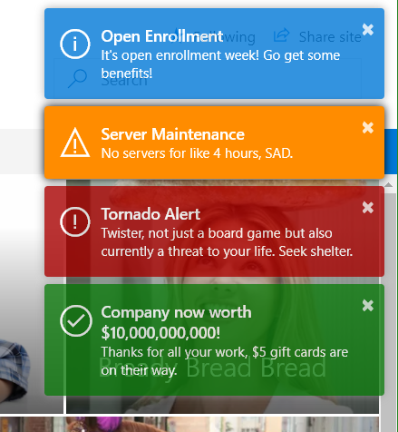
SPFx Extensions: Application Customizer
Purpose:
Parallel with classic SharePoint Dev:
Inject custom JavaScript on the page
Insert custom HTML to well-known locations on the page - Placeholders
ScriptLink Custom Action
Delegate Controls
Use case examples:
Notification banners
Custom footers
Pop up messages
https://goo.gl/51LkYj
https://goo.gl/MgaVTC
https://goo.gl/azrZ1a

Slide 19
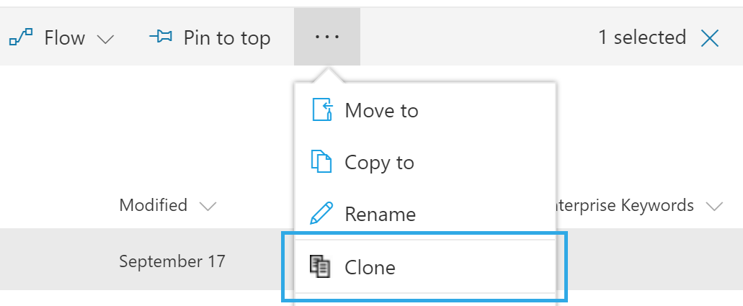
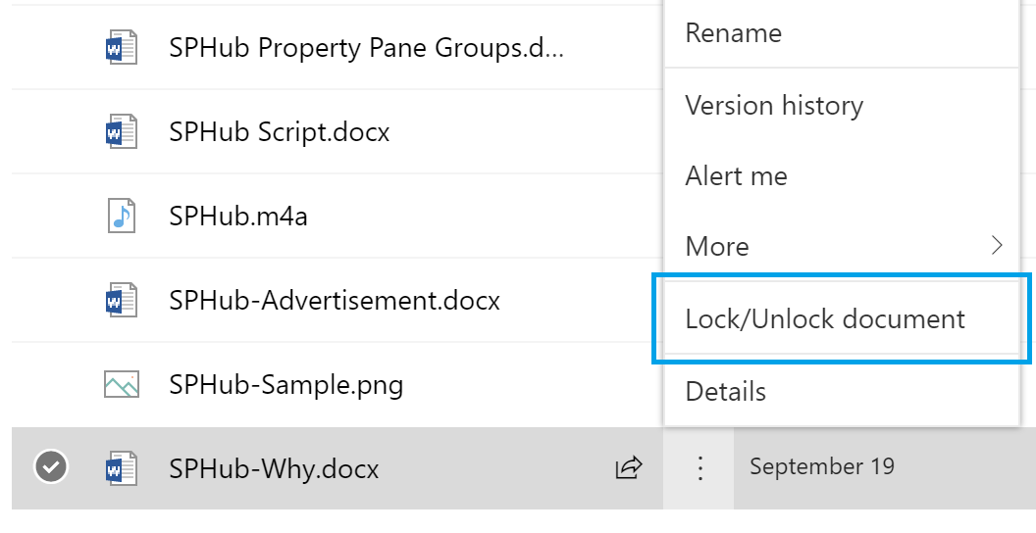
SPFx Extensions: Command Set Customizer
Purpose:
Parallel with classic SharePoint Dev:
Insert custom commands to Lists’ command bar
Insert custom commands to List Items’ context menu (ECB)
Ribbon and ECB Custom Actions
Use case examples:
Clone selected items
Lock Item/Document
Shortcut to set unique permissions
https://goo.gl/irNrbs
https://goo.gl/27AC56
https://goo.gl/K8e3XP

Slide 20
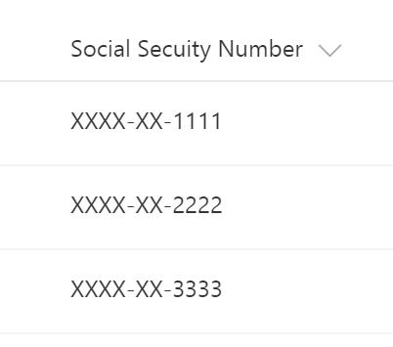
SPFx Extensions: Field Customizer
Purpose:
Parallel with classic SharePoint Dev:
Provide custom experience to a field
Field JSLink
Use case examples:
Color-coding
SSN-masking
Inline editing controls
https://goo.gl/QAzrk2
https://goo.gl/SdQNdP

Slide 21
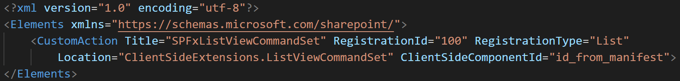
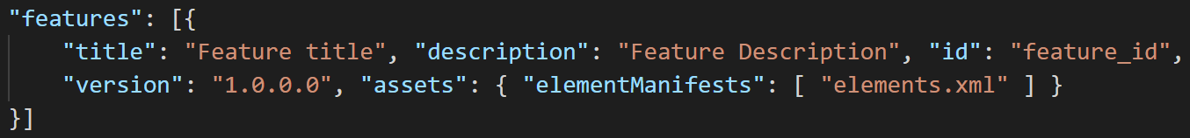
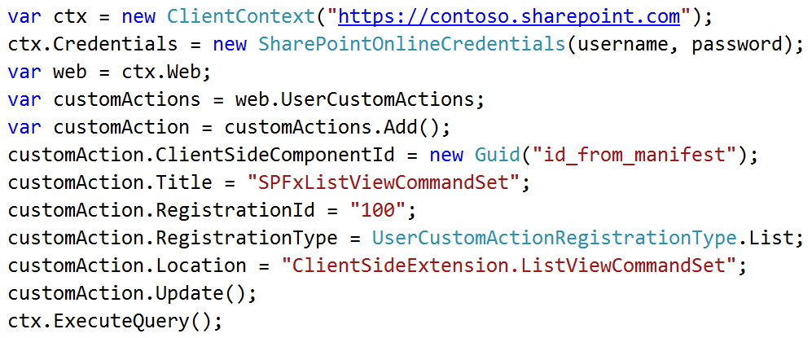
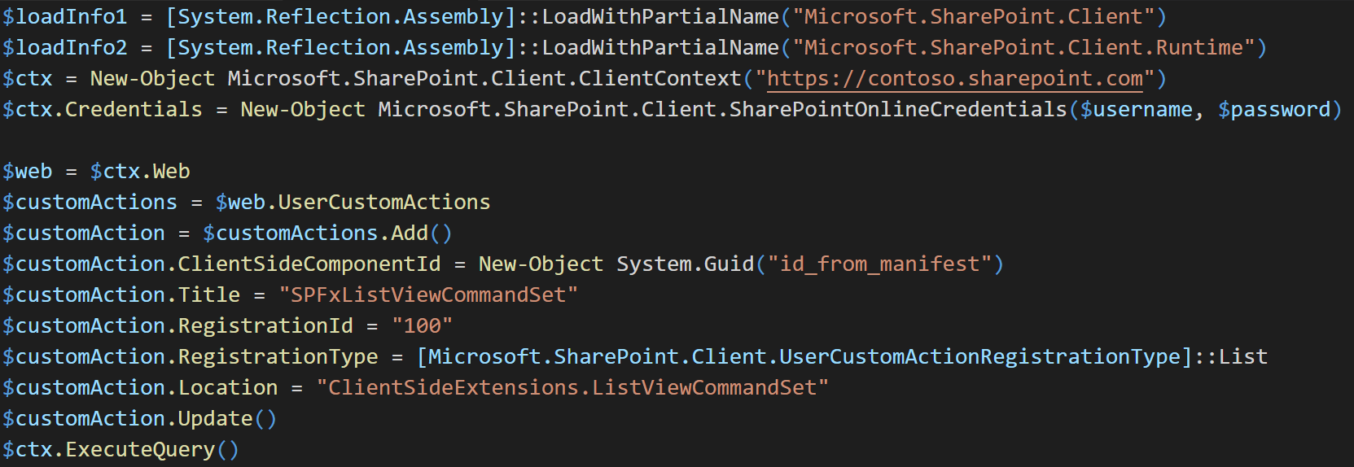
SPFx Extensions: Applying
Feature Framework
CSOM/JSOM
PowerShell

Slide 22
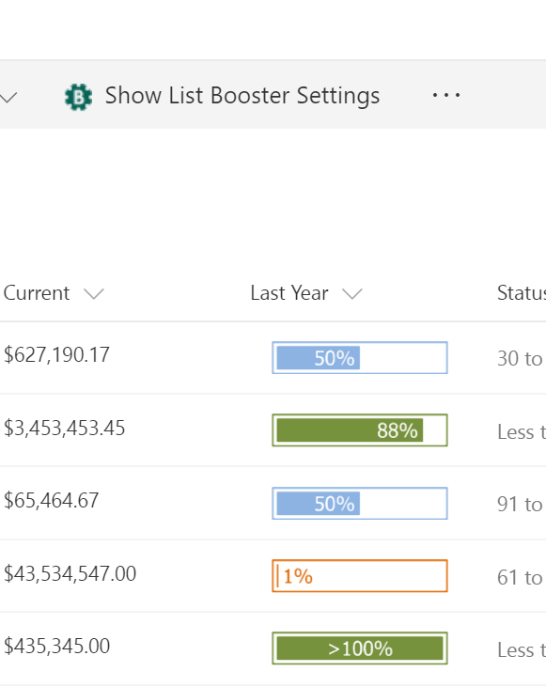
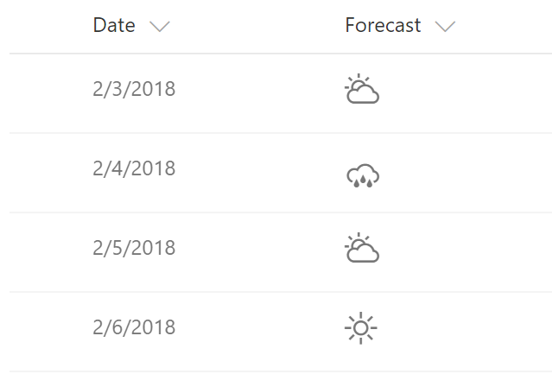
SPFx Extension Demos
What is SharePoint Framework?
SharePoint Framework Development Overview
SharePoint Framework Extensions Overview
SharePoint Framework Extensions Demos

Slide 23
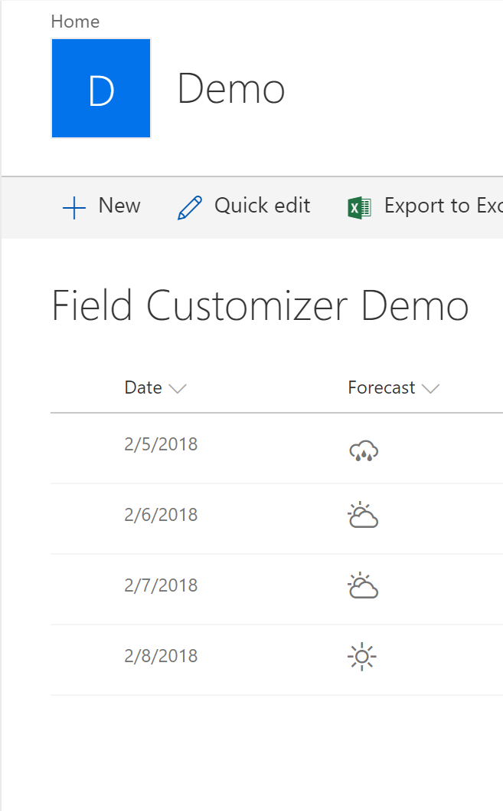
Field Customizer Demo
https://github.com/AJIXuMuK/demos/tree/master/field-customizer

Slide 24
Resources
Documentation
https://docs.microsoft.com/en-us/sharepoint/dev/spfx/sharepoint-framework-overview - main documentation
https://github.com/SharePoint/sp-dev-docs/wiki - Wiki
Updates and Feedback
Follow @SharePoint and @OfficeDev on Twitter
http://dev.office.com/blogs - Office Development Blog
https://github.com/SharePoint/sp-dev-docs/issues - Repository for issues and questions
https://sharepoint.uservoice.com/forums/329220-sharepoint-dev-platform - features/improvements requests
https://techcommunity.microsoft.com/t5/SharePoint-Blog/bg-p/SPBlog - The SharePoint Community Blog
Office Dev Patterns & Practices
https://aka.ms/sppnp - entry point to all SharePoint PnP resources
GitHub
https://github.com/SharePoint - SharePoint GitHub profile with PnP, SPFx and some other repos

Slide 25
Q&A

Slide 26

Alex Terentiev
@alexaterentiev
http://blog.aterentiev.com/

Slide 27


Our Sponsors

